Slide 1




Going for gold
How do countries and territories
compete when it comes to healthy ageing?

Slide 2
Contents
Acknowledgements
Project overview
Our Healthy Ageing Medal Table
Findings
Recommendations
Conclusion

Slide 3

Acknowledgements
This project has been financially supported by Sanofi.

Slide 4
Project overview
Contents page

Slide 5
Physical activity and prevention are key for healthier lives
The world is ageing – by 2050 one in six people will be aged 65 and over. Helping everyone remain in good health is key to improving longevity and achieving longer, healthier lives.
We know physical activity can keep people healthier for longer
and make an early death less likely. Preventative healthcare can also support longer lives by reducing the burden of disease at the population level.
Notes:
https://www.who.int/news-room/fact-sheets/detail/ageing-and-health
https://www.hsph.harvard.edu/news/hsph-in-the-news/exercising-more-than-recommended-could-lengthen-life-study-suggests/

Slide 6
Why are healthy ageing and prevention important?
Investing in people’s health is vital for everyone’s wellbeing. It can also ensure that we can all truly benefit from the ‘longevity dividend’ associated with an ageing population.
We know that in countries which spend more on health, older people work, volunteer and spend for longer.
Yet around the globe, action on, and investment in, healthy ageing and preventative health is still not being prioritised at the policy level.
Notes:
https://ilcuk.org.uk/healthequalswealth/

Slide 7

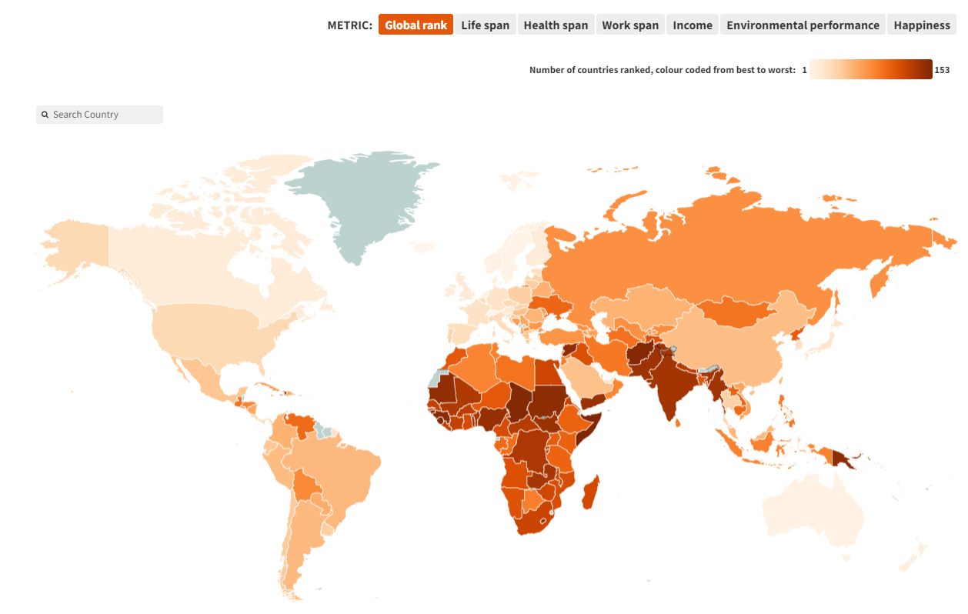
Healthy Ageing and Prevention Index
The ILC Healthy Ageing and
Prevention Index compares countries in terms of their levels of investment in efforts to prevent ill health and support healthy ageing.
The Index ranks 153 countries across six metrics, which relate to healthy ageing.

Slide 8
How do countries compare when it comes to different aspects of healthy ageing?
We’ve produced a Healthy Ageing Medal Table, using findings from our Index, the OECD, UN, World Bank and WHO. This helps us understand how countries and territories perform on:
Immunisation
Preventative healthcare
Healthy life expectancy
Physical activity

Slide 9
So, if healthy ageing and prevention were Olympic disciplines…
…who would win?

Slide 10
Healthy Ageing Medal Table
Contents page

Slide 11
Our research findings
Our Healthy Ageing Medal Table profiles 69 countries and territories (including overseas territories and some contested states) that are included in WHO datasets.
While a country or territory may win a medal, this reflects the data and methodology used to calculate that finding, rather than that place’s overall health status.
The Healthy Ageing Medal Table explores certain aspects of healthy ageing and prevention that don’t correlate with overall population health outcomes.

Slide 12
Our Healthy Ageing Medal Table
We’ve created a ‘medal table’ to rank these regions on different healthy ageing disciplines – described as if they were ‘sporting’ categories.
Our table has eight categories, with 24 medals up for grabs:
Jab-elin
Archery
Prevention Triathlon
Sport climbing
Race walking
Marathon
100m sprint
Relay race

Slide 13
Our eight sporting categories
Four events relate to immunisation and prevention:
Jab-elin: how well nations perform on coverage across five childhood immunisation programmes.
Archery: how well nations perform on meeting WHO immunisation targets for measles and influenza (flu).
Prevention Triathlon: how nations score on the prevalence of three lifestyle circumstances related to prevention (diet, diabetes and tobacco use).
Sport climbing: how far how countries have ‘climbed’ the Healthy Ageing and Prevention Index.

Slide 14
Our eight sporting categories
Four events relate to healthy life expectancy and physical activity:
Race walking: how well nations perform when it comes to physical activity.
Marathon: how well nations perform on healthy life expectancy.
100m sprint: nations with the most centenarians as a percentage of their population.
Relay race: how economic and political blocs perform on the Healthy Ageing and Prevention Index.

Slide 15
What should countries and territories do to achieve healthy ageing?
Invest in health systems: governments should invest more in prevention and public health initiatives.
Inspire and engage key actors: policymakers, health leaders and citizens need to work together to prioritise prevention.
Democratise access to healthcare: barriers to preventative interventions need to be removed.
Use technology to deliver prevention: use technology to support access to preventative healthcare services.

Slide 16
Findings
Contents page

Slide 17
1. Jab-elin
What is the Jab-elin in our Olympics?
The Jab-elin explores how regions perform when it comes to coverage across five childhood immunisation programmes, using WHO data.
Fun fact: Finland (for men) and Germany (for women) are the most successful countries with the javelin at the real Olympic Games, but only rank 50th and 62nd respectively out of 195 countries on our Jab-elin table.

Slide 18
How did we measure the Jab-elin?
We took our Jab-elin data from the WHO Immunization Data Portal. We’ve used figures from the WHO/UNICEF Estimates of National Immunization Coverage (WUENIC).
We calculated the 10-year average¹ for WUENIC figures on five childhood vaccines: DTP-containing* (3rd dose), Hib* (3rd dose), measles-containing (2nd dose), pneumococcal (PCV, final dose), rubella-containing (1st dose). We then calculated the average across all five combined to produce a final figure.
¹The 10-year period is from 2013 to 2022.
Notes:
https://immunizationdata.who.int/
*The DTP vaccine protects against diphtheria, tetanus and polio. The Hib/MenC vaccine helps prevent Haemophilus influenzae type b (Hib) and the type of meningitis caused by group C bacteria.

Slide 19




Who wins gold in Jab-elin?
And the winner is…
1st place: Niue – 99.0%
2nd place: Oman – 98.8%
3rd place: Bahrain & Hungary – 98.6%

Slide 20
Jab-elin top 10
Position | Country/territory | DTP-containing 10-year average (%) | Hib3 10-year average (%) | Measles-containing 10 year-average (%) | Pneumococcal 10-year average (%) | Rubella-containing 10-year average (%) | Overall average (%)
1 | Niue | 99.0 | 99.0 | 99.0 | 99.0 | 99.0 | 99.0
2 | Oman | 98.9 | 98.9 | 98.8 | 98.6 | 98.8 | 98.8
=3 | Hungary | 99.0 | 99.0 | 99.0 | 97.1 | 99.0 | 98.6
=3 | Bahrain | 98.3 | 98.3 | 99.0 | 98.4 | 99.0 | 98.6
5 | Palestine | 98.4 | 98.1 | 98.3 | 98.0 | 98.7 | 98.3
6 | Uzbekistan | 98.1 | 98.1 | 99.0 | 97.3 | 98.4 | 98.2
7 | South Korea | 98.1 | 97.2 | 96.0 | 97.3 | 98.0 | 97.3
=8 | Saudi Arabia | 97.2 | 97.2 | 96.9 | 97.4 | 97.3 | 97.2
=8 | Morocco | 99.0 | 99.0 | 93.6 | 95.3 | 99.0 | 97.2
10 | United Arab Emirates | 97.2 | 97.3 | 95.9 | 96.3 | 98.8 | 97.1

Slide 21
Our Jab-elin medalists
Gold: Niue
Niue is a self-governing island country in free association with New Zealand. According to a 2022 census, it has a population of 1,681. New Zealand ranks 8th on the Index.
Niue has never competed at the Olympics, but it has participated in the Commonwealth Games.
Niue’s population includes fewer than 150 children under five years of age, which has probably helped them to deliver such successful childhood immunisation programmes.

Slide 22
Our Jab-elin medalists
Silver: Oman
With a population of 4.5 million people, Oman ranks 80th on the Index. Oman has competed at the Olympics since Los Angeles 1984 but has never won a medal.
Oman’s Ministry of Health offers universal health coverage (UHC) to all Omani nationals. The country has seen a dramatic increase in life expectancy since the 1950s.
Oman has a very strong childhood immunisation programme, with WHO estimates suggesting it achieves almost 100% coverage for every vaccination included in its programme.
Notes:
https://ourworldindata.org/life-expectancy

Slide 23
Our Jab-elin medalists
Bronze: Bahrain
Bahrain is a small island nation in the Persian Gulf with a population of 1.5 million. It has competed in the Olympics since 1984, winning four medals (2 gold, 2 silver) in athletics events.
Bahrain initiated an objective called Healthcare for All in the 1990s. Today, it continues to provide a range of free and subsidised healthcare services to citizens and residents alike.
Bahrain offers free vaccinations for newborns, followed by periodic vaccinations for children until they start school.
Notes:
https://www.bahrain.bh/wps/portal/en/BNP/YourGuideForLivingInBahrain/Healthcare
https://www.moh.gov.bh/HealthInfo/Immunizations

Slide 24
Our Jab-elin medalists
Bronze: Hungary
Hungary has a population of almost 10 million. It ranks 48th on the Index.
Hungary has competed at the Summer Olympics since 1896, winning a total of 511 medals. It has been most successful in the modern pentathlon and water polo.
Hungary has a UHC system, largely financed by government national health insurance. Childhood immunisation is mandatory, hence the high coverage rates.
Notes:
https://vaccine-schedule.ecdc.europa.eu/Scheduler/ByCountry?SelectedCountryId=95&IncludeChildAgeGroup=true&IncludeChildAgeGroup=false&IncludeAdultAgeGroup=true&IncludeAdultAgeGroup=false

Slide 25
Global childhood immunisation coverage since 2000 (WHO)

Slide 26
2. Archery
What is archery in our Olympics?
Archery explores which regions come closest to meeting the WHO immunisation coverage targets for measles in children (95%) and flu in older people (75%).
Fun fact: South Korea is the most successful country in archery at the real Olympics, winning 27 gold medals – almost twice as many as the US, in 2nd place with 14.

Slide 27
How did we measure Archery?
Our archery data is based on figures from the WHO Immunization Data Portal and the OECD Health at a Glance 2023 report. We calculated an average using:
WHO/UNICEF Estimates of National Immunization Coverage figures for 2nd dose of measles-containing vaccine (WHO, 2022)
The percentage of people aged 65 and over vaccinated for flu in 2021 (OECD Health Statistics 2023)
Criteria for a medal position included meeting the target for either measles (95%) or flu (75%).

Slide 28
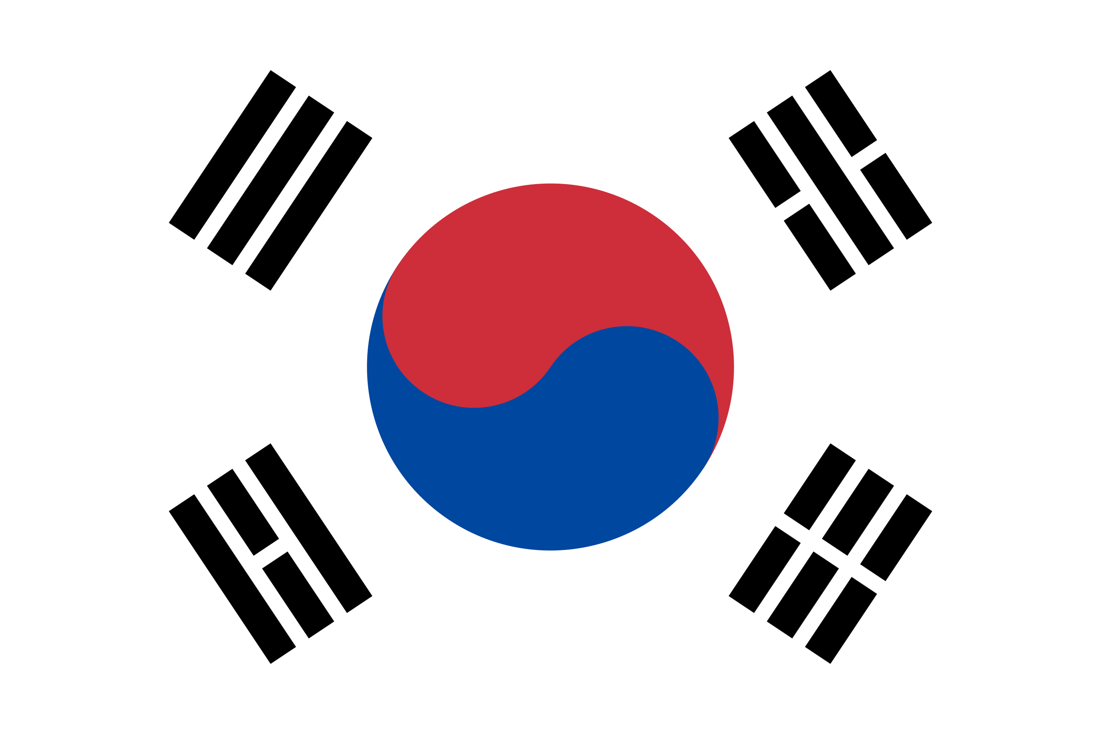
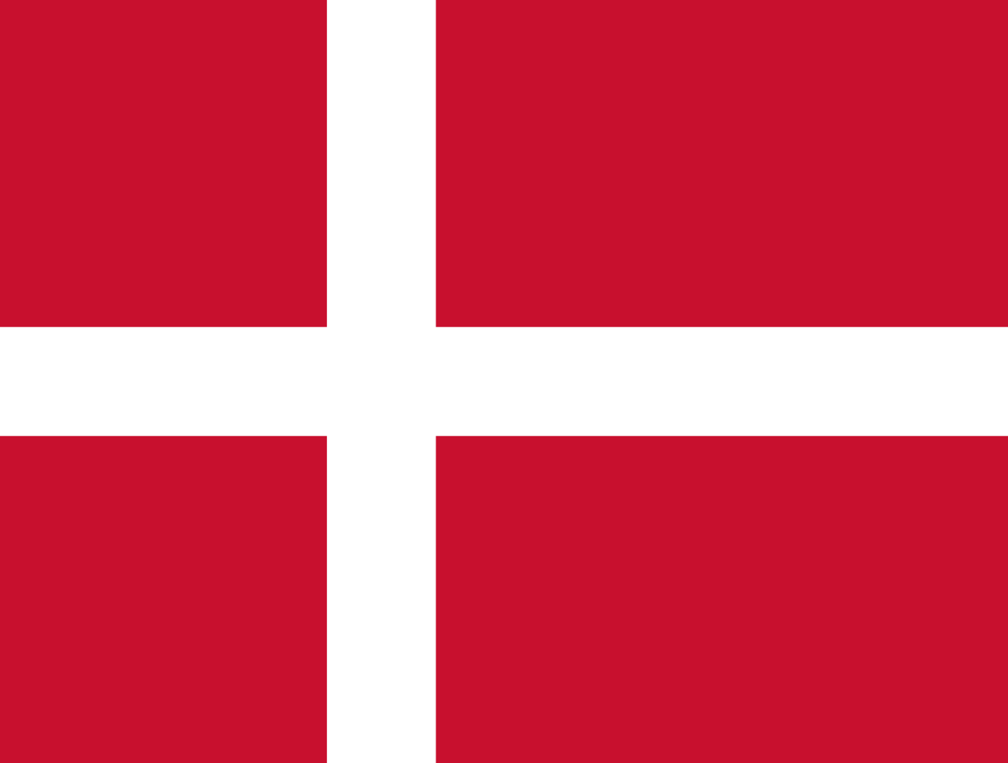

Who wins gold in Archery?
And the winner is…
1st place: South Korea – 87.6%
95.0% measles / 80.1% flu
2nd place: Denmark – 84.5%
94.0% measles / 75.0% flu
3rd place: United Kingdom – 84.0%
87.0% measles / 80.9% flu

Slide 29
Archery top 10
Position | Country/territory | Flu coverage (%) | Measles coverage (%) | Average: measles & flu (%)
1 | South Korea | 80.1 | 95.0 | 87.6
2 | Denmark | 75.0 | 94.0 | 84.5
3 | UK | 80.9 | 87.0 | 84.0
4 | USA | 72.8 | 95.0 | 83.9
5 | Ireland | 75.4 | 90.0 | 82.7
6 | Portugal | 66.2 | 96.0 | 81.1
7 | Japan | 66.0 | 95.0 | 80.5
8 | Spain | 67.7 | 92.0 | 79.9
9 | Norway | 65.5 | 94.0 | 79.8
10 | Netherlands | 72.6 | 85.0 | 78.8
Bold figures indicate that the WHO immunisation target was met.

Slide 30
Our archery medalists
Gold: South Korea
South Korea wins our archery gold – and it’s also the most successful country in this sport at the Summer Olympics.
South Korea has competed at 18 Summer Olympics, winning 288 medals. In addition to archery, it’s been most successful at taekwondo – a Korean sport.
With 52 million people, South Korea has a rapidly ageing population – 40% will be aged 65 or over by 2050 (currently 17%). Fortunately, it has one of the OECD’s highest flu vaccination coverage rates for people aged over 65.

Slide 31
Our archery medalists
Silver: Denmark
Denmark is one of the highest performing countries on the Index (9th). It has a population of 6 million – and its people are some of the happiest in the world (3rd on the Index).
Denmark has participated in all but one of the Summer Olympics, winning a total of 205 medals. It’s been most successful at sailing.
Denmark has one of the world’s highest UHC scores, at 82/100 – much higher than the global average (68).

Slide 32
Our archery medalists
Bronze: United Kingdom
The UK has a population of 68 million. It ranks 14th on the Index. It has hosted the second-highest number of Olympic Games (1908, 1948 and 2012 in London). Team GB has won 916 medals and ranks 3rd in the all-time medal table.
While health is devolved across the four home nations (England, Northern Ireland, Scotland, and Wales), the NHS offers treatment free at the point of use. This includes a comprehensive life course immunisation schedule. Flu vaccination coverage for people aged over 65 has been consistent: England has approached or reached the WHO’s 75% target since 2004.

Slide 33
Measles and flu immunisation since 2000 (WHO/OECD)
*Member state data missing for some years.

Slide 34
3. The Prevention Triathlon
What is the Prevention Triathlon in our Olympics?
Our Prevention Triathlon explores how regions score on the prevalence of three lifestyle circumstances related to prevention: diet, diabetes and tobacco use.
Fun fact: the UK is the most successful country in the real Olympic triathlon, with the Brownlee brothers winning gold and bronze at London 2012, and gold and silver at Rio 2016.

Slide 35
How did we measure the Prevention Triathlon?
To calculate a healthy eating score for each country, we combined data on obesity from the World Obesity Federation and data on undernourishment from the World Bank. We collected data on tobacco use and diabetes to ascertain the percentage of adult smokers per population and the prevalence of diabetes in people aged 20 to 79.
We added the scores for these metrics together and found the total lowest scores to reveal our winners.

Slide 36

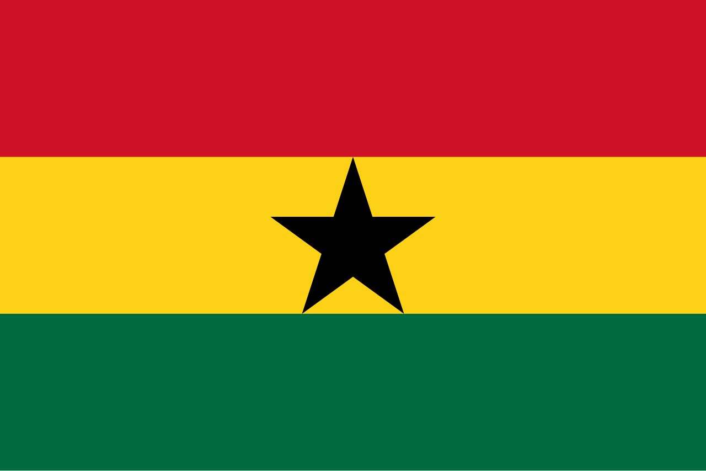
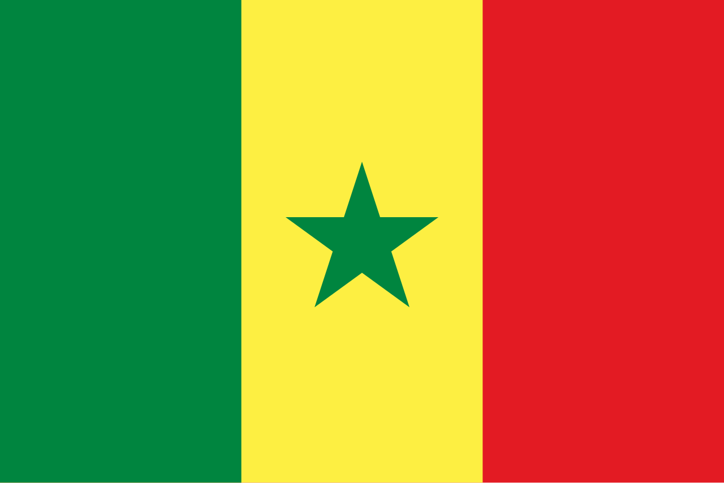
Who wins gold in the Prevention Triathlon?
And the winner is…
1st place: Nigeria – total score of 24.1
2nd place: Ghana – total score of 24.4
3rd place: Senegal – total score of 26.2

Slide 37
Prevention Triathlon top 10
Position | Country/territory | Healthy eating (combined score for undernourishment and obesity) | Prevalence of tobacco use (% of adults) | Prevalence of diabetes (% of population aged 20-79) | Sum total
1 | Nigeria | 16.8 | 3.7 | 3.6 | 24.1
2 | Ghana | 18.3 | 3.5 | 2.6 | 24.4
3 | Senegal | 16.2 | 6.9 | 3.1 | 26.2
4 | Benin | 21.5 | 6.9 | 1.1 | 29.5
5 | Cameroon | 21.5 | 7.3 | 5.5 | 34.3
6 | Cote d'Ivoire | 20.1 | 9.4 | 4.8 | 34.3
7 | Niger | 22.2 | 7.4 | 5.2 | 34.8
8 | Ethiopia | 24.9 | 5.1 | 5.0 | 35.0
9 | Mali | 24.8 | 8.2 | 2.1 | 35.1
10 | Japan | 8.6 | 20.1 | 6.6 | 35.3

Slide 38
Our Prevention Triathlon medalists
Gold: Nigeria
With over 218 million people, Nigeria has the largest population in Africa. It ranks 142nd on the Index. The country has won 27 Olympic medals, with three golds, since it first competed in 1952.
Despite a range of health challenges, life expectancy here has increased from 53.6 years in 2000 to 63.4 years in 2021.
As in many African countries, diabetes is far less of a strain on health systems than in developed countries. Diet, exercise and a younger population all contribute to this.
Notes:
https://data.who.int/countries/566

Slide 39
Our Prevention Triathlon medalists
Silver: Ghana
Ghana first competed in the Olympics in 1952; it holds five medals. It ranks 115th on the Index, and has a population of 33 million.
Maternal and child health is a major challenge. Efforts to improve childhood vaccination levels have been successful: MMR coverage went from 53.7% in 2021 to 98.9% in 2022.
Similarly to Nigeria, Ghana’s diabetes levels remain low, as does the level of tobacco use.
Notes:
https://www.gavi.org/vaccineswork/learning-across-borders-boosting-immunisation-coverage-ghana
https://www.who.int/news-room/fact-sheets/detail/tobacco#:~:text=Key%20facts,%2D%20and%20middle%2Dincome%20countries.

Slide 40
Our Prevention triathlon medalists
Bronze: Senegal
With a population of 17.32 million, Senegal ranks 123rd on the Index. It has competed in the Summer Olympics since 1964, winning one silver medal for athletics. Senegal, Nigeria and Ghana are all part of the small group of African countries that have also competed at the Winter Olympics.
Despite challenges with communicable disease and urban-rural inequalities, upcoming ILC research shows that Senegal has made great improvements in UHC. Between 2000 and 2021, it saw the third-highest coverage increase in Africa, and the 13th highest increase worldwide.
Notes:
https://olympics.com/en/news/africa-at-the-olympic-winter-games-a-brief-history

Slide 41
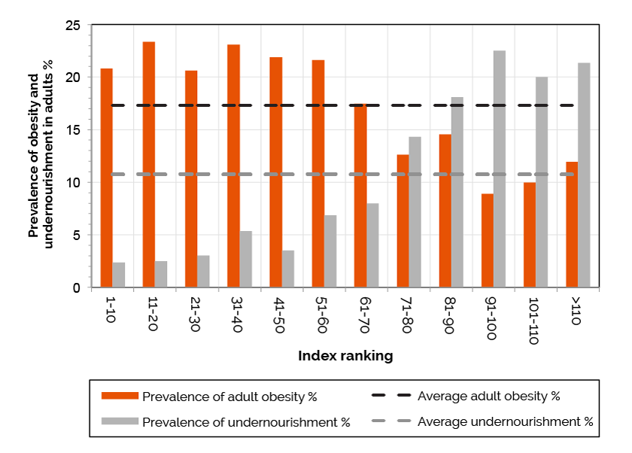
Index findings on malnutrition
In the Index, higher-ranked countries have a greater obesity burden, while lower- ranked ones have a greater burden of undernourishment.
88% of countries worldwide experience more than one form of poor nutrition.

Slide 42
4. Sport climbing
What is sport climbing in our Olympics?
Sport climbing looks at how far how countries have climbed the Healthy Ageing and Prevention Index rankings when we compare 2019 and 2022 data.
Fun fact: sport climbing made its Olympic debut at Tokyo 2020, with Spain taking gold in the men’s event and Slovenia in the women’s event.

Slide 43
How did we measure sport climbing?
We based our sport climbing scores on a comparison of Wave 1 (2019) with Wave 2 (2022) Index data.
The number of places climbed indicates how much a country’s Index position has improved across six healthy ageing metrics.

Slide 44





Who wins gold in our sport climbing?
And the winner is…
1st place: Botswana ↑ 24 places
2nd place: Latvia, Saudi Arabia & Zimbabwe ↑ 13 places
3rd place: Rep. of the Congo ↑ 11 places

Slide 45
Sport climbing top 10
Position | Country/territory | Index places climbed (2019 vs 2022)
1 | Botswana | 24
=2 | Latvia | 13
=2 | Saudi Arabia | 13
=2 | Zimbabwe | 13
3 | Republic of the Congo | 11
=4 | Mexico | 10
=4 | Nicaragua | 10
=6 | Uzbekistan | 9
=6 | Niger | 9
=6 | Burundi | 9
=8 | Estonia | 8
=8 | Croatia | 8
=8 | Vietnam | 8
=8 | Cuba | 8
=8 | Central African Republic | 8
=8 | Togo | 8
=10 | Algeria | 7
=10 | Gabon | 7
=10 | Tanzania | 7

Slide 46
Our sport climbing medalists
Gold: Botswana
Botswana has a population of 2.4 million. It ranks 85th on the Index: the second-highest African country behind Algeria (81st).
Botswana has competed at the Olympics since Moscow 1980, winning two medals – a silver at London 2012 (800m) and a bronze at Tokyo 2020 (men's 4 × 400m relay).
Despite a previous fall in life expectancy due to the HIV/AIDS epidemic, Botswana was the first country in Africa to offer anti-retroviral drugs (ARVs) and is one of only five countries to reach the UNAIDS’ 95-95-95 goal.*
Notes:
https://www.un.org/africarenewal/magazine/september-2002/botswanas-high-stakes-assault-aids
https://www.unaids.org/en/resources/presscentre/pressreleaseandstatementarchive/2023/november/20231129_new-research-on-opt-out-hiv-testing-england
*This means that 95% of people with HIV know their HIV status, 95% of people that know their status are on ARVs, and 95% of people on ARVs are virally suppressed.

Slide 47
Our sport climbing medalists
Silver: Latvia
Latvia ranks 35th on the Index. It has a population just shy of
2 million. Latvia ranks higher than its peers in the Baltic states and Eastern Europe, except for Estonia (25th).
Since independence in 1991, Latvia has taken 18 medals at the Summer Olympics, winning gold in cycling, gymnastics and the 3 x 3 basketball.
Latvia has a UHC system largely funded through taxation. Latvia spends 7.5% of its GDP on healthcare, which compares with the EU average of 10.9%.
Notes:
https://ec.europa.eu/eurostat/statistics-explained/index.php?title=Healthcare_expenditure_statistics

Slide 48
Our sport climbing medalists
Silver: Saudi Arabia
Saudi Arabia has a population of 37 million. It ranks 47th on the Index, making it the fourth-highest ranked Arab nation, behind Qatar (46th), Kuwait (19th) and the UAE (17th).
Since first competing at Munich 1972, it has won four medals – two silver and two bronze (with both bronzes in equestrian).
Saudi Arabia provides free healthcare to its citizens through government agencies. The Saudi Ministry of Health recently launched a Diet and Physical Activity Strategy to combat obesity and physical inactivity.
Notes:
https://extranet.who.int/ncdccs/Data/SAU_B11_KSA%20NATIONAL%20STRATEGY%20FOR%20DIET%20AND%20PHYSICAL%20ACTIVITY.pdf

Slide 49
Our sport climbing medalists
Silver: Zimbabwe
With 16 million people, Zimbabwe ranks 118th on the ILC’s Index.
Zimbabwe has competed at the Summer Olympics since its formation in 1980, winning a total of eight medals. Seven of these were won by Kirsty Coventry for swimming, while the women’s field hockey team took gold in 1980.
Like Botswana, Zimbabwe has faced challenges with the HIV/AIDS epidemic, but has also reached UNAIDS’ 95-95-95 goal. After declining in the 1990s, life expectancy in Zimbabwe started rising in the early 2000s.
Notes:
https://www.unaids.org/en/resources/presscentre/pressreleaseandstatementarchive/2023/november/20231129_new-research-on-opt-out-hiv-testing-England
https://ourworldindata.org/life-expectancy

Slide 50
Our sport climbing medalists
Bronze: Republic of the Congo
The Republic of the Congo ranks 94th on the Index. It has a population of 6 million. Since first competing at Tokyo 1964, the country has never won a medal.
The Republic of the Congo has produced some of the youngest Olympians – its youngest athlete, who competed at Munich 1972, was 15, while its oldest athlete, at Barcelona 1992, was 36.
It has climbed into the top 100 countries on the Index: life expectancy has increased almost 60% there since 1950.
Notes:
https://ourworldindata.org/life-expectancy

Slide 51
5. Race walking
What is race walking in our Olympics?
Race walking examines how regions perform when it comes to physical activity.
Fun fact: although men have competed in Olympic race walking since London 1908, it was only introduced for women at Barcelona 1992. Poland is one of the most successful countries in this event (with 4 gold medals for the men’s 50km).

Slide 52
How did we measure race walking?
We took figures from the WHO Global status report on physical activity 2022. We combined each country’s male and female adult (18+) physical inactivity rate to create an average adult inactivity rate, defined as:
Age-adjusted prevalence of adults (over 18 years of age) that do not meet physical activity recommendations; which for adults is at least 150 minutes of moderate-intensity aerobic physical activity; or at least 75 minutes of vigorous intensity aerobic physical activity; or an equivalent combination of moderate- and vigorous-intensity activity throughout the week.

Slide 53
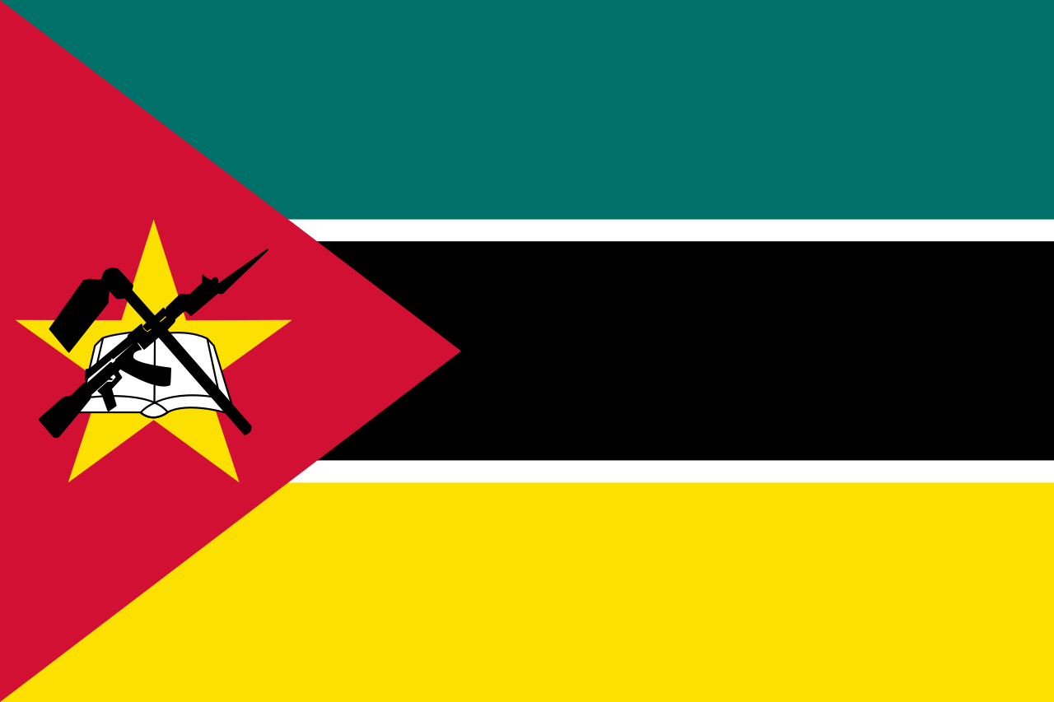

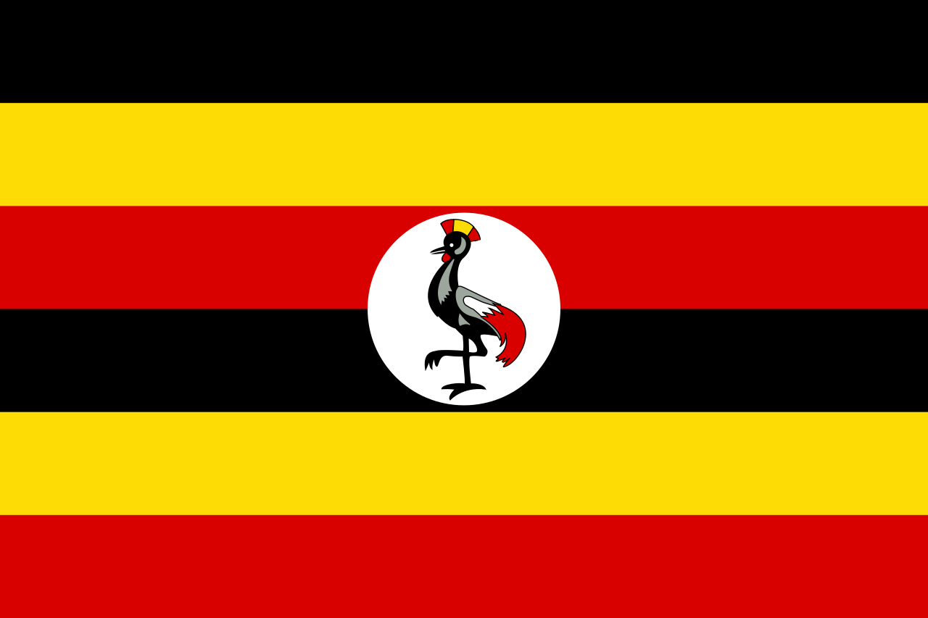

Who wins gold in race walking?
And the winner is…
1st place: Mozambique & Uganda – 5.5%
2nd place: Lesotho & Tanzania – 6.5%
3rd place: Niue – 7.0%

Slide 54
Race walking top 10
Position | Country/territory | Physical inactivity in men aged 18+ (%) | Physical inactivity in women aged 18+ (%) | Average physical inactivity, all adults aged 18+ (%)
=1 | Mozambique | 5.0 | 6.0 | 5.5
=1 | Uganda | 5.0 | 6.0 | 5.5
=2 | Lesotho | 7.0 | 6.0 | 6.5
=2 | Tanzania | 6.0 | 7.0 | 6.5
3 | Niue | 8.0 | 6.0 | 7.0
4 | Vanuatu | 7.0 | 9.0 | 8.0
5 | Togo | 9.0 | 10.0 | 9.5
=6 | Cambodia | 10.0 | 11.0 | 10.5
=6 | Myanmar | 8.0 | 13.0 | 10.5
8 | Moldova | 12.0 | 11.0 | 11.5
9 | Jordan | 10.0 | 14.0 | 12.0
10 | Samoa | 8.0 | 17.0 | 12.5

Slide 55
Our Race walking medalists
Gold: Mozambique
Mozambique has a population of 33 million and ranks 113th on the Index. It has competed at the Summer Olympics since Moscow 1980. Maria de Lurdes Mutola won both of its two medals for the 800m (bronze at Atlanta 1996 and gold at Sydney 2000).
Mozambique has a high fertility rate: 4.64 births per woman. 83% of the population is under the age of 40. Since 2000, Mozambique’s UHC score has improved from 20/100 to 44/100, in line with the score for Africa as a whole (44/100).
Notes:
https://datacommons.org/tools/timeline#&place=country/MOZ&statsVar=FertilityRate_Person_Female
https://www.populationpyramid.net/mozambique/2021/
https://data.who.int/indicators/i/3805B1E/9A706FD#:~:text=The%20index%20is%20reported%20on,100%20being%20the%20optimal%20value.&text=Due%20to%20data%20limitations%2C%20not,when%20more%20data%20become%20available.

Slide 56
Our race walking medalists
Gold: Uganda
Ranked 103rd on the Index, Uganda has a population of
47 million. Since competing at Melbourne 1956, Uganda has won 11 medals. Four of these were at Tokyo 2020, in long-distance athletics events.
Uganda eliminated user fees for healthcare in 2001, resulting in an 80% increase in health visits. Life expectancy has steadily increased since 1950. The country has also seen a decrease in HIV infection rates, from 6.97 per 1,000 people in 1990 to 1.21 per 1,000 in 2022.
Notes:
https://wayback.archive-it.org/all/20171012091618/https://www.odi.org/sites/odi.org.uk/files/odi-assets/publications-opinion-files/5834.pdf
https://data.worldbank.org/indicator/SH.HIV.INCD.TL.P3?end=2022&locations=UG&name_desc=true&skipRedirection=true&start=1990&view=chart

Slide 57
Our race walking medalists
Silver: Lesotho
Lesotho has a population of 2.3 million. It ranks 143rd on the Index. It’s never won an Olympic medal since its debut in 1972.
Despite its low Index ranking, Lesotho has high levels of physical activity, which may be linked to its geography. Over 80% of the country lies above 1,800m, leading to its being known as the “The Mountain Kingdom”.
Its terrain and mostly-rural population (around 70%) make walking and active travel more likely.
Notes:
https://www.cia.gov/the-world-factbook/countries/lesotho/
https://www.cia.gov/the-world-factbook/countries/lesotho/

Slide 58
Our race walking medalists
Silver: Tanzania
Tanzania ranks 99th on the Index. It has a population of
66 million. Since its debut at Tokyo 1964, Tanzania has won two silver medals – at 1980 Moscow, in the men’s 5000m and the men’s 3000m steeplechase.
Despite national health challenges that include malaria and the HIV/AIDS epidemic, Tanzania has seen improvements in life expectancy, from 41 years in 1950 to 67 years in 2022.
Its population is largely rural (around 70%), with many living in mountainous and tropical areas that are not easy for vehicles to access.
Notes:
https://ourworldindata.org/life-expectancy
http://www.preventionindex.org/
https://web.archive.org/web/20180710194919/http://www.thecitizen.co.tz/News/Report-reveals-rapid-rural--urban-migration-/-/1840392/2006950/-/m6w9qv/-/index.html

Slide 59
Our race walking medalists
Bronze: Niue
Given its size and rural island status, active travel is more likely in Niue. As a result, its adult population has relatively high levels of physical activity.
With a surface area of 259km² (100 square miles) and a diameter of around 18km, it would take the average person about 3.6 hours to walk around Niue.*
Alofi is the second-smallest capital city of a sovereign state (by population) in the world, with just over 600 people.
Notes:
https://www.gov.nu/
*It takes the average person 1 hour to walk 5km. 18km / 5km/h = 3.6 hours.

Slide 60
6. Marathon
What is the marathon in our Olympics?
We use the ILC Index to see which countries perform the best on healthy life expectancy.
Fun fact: Ethiopia and Kenya dominate the real Olympic marathon. Since Sydney 2000, Ethiopian and/or Kenyan athletes have finished in a medal position at each of the men’s and women’s marathon events.

Slide 61
How did we measure our marathon?
Our marathon is based on data from the Index’s “Health span” metric.
This is the number of years an individual can expect to spend in good health. It’s measured at birth in years, using health expectancy measures obtained from WHO.

Slide 62
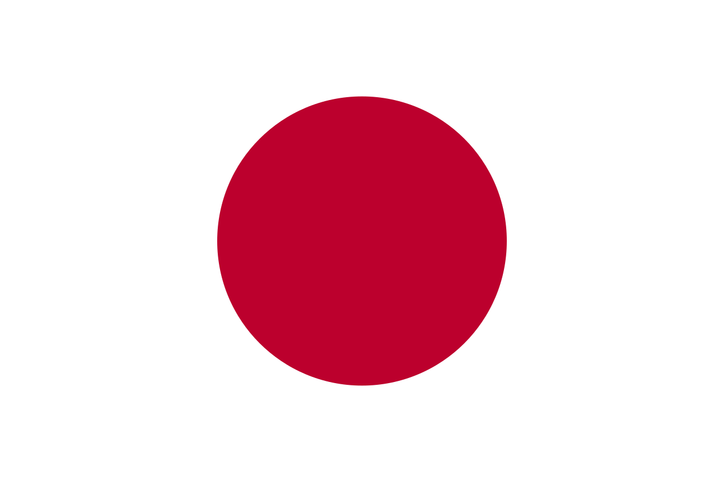
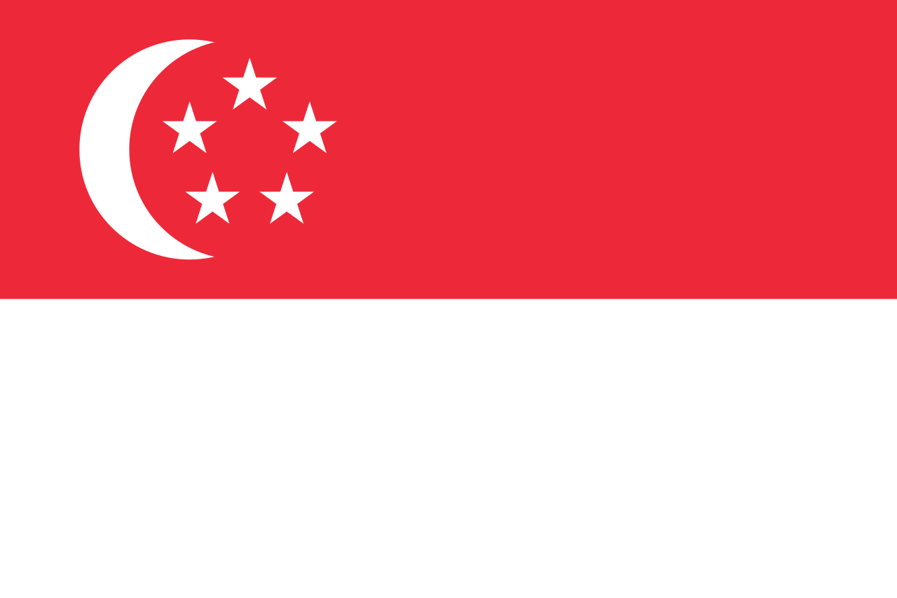
Who wins gold in our marathon?
And the winner is…
1st place: Japan – 74.4 years
2nd place: Singapore – 74.2 years
3rd place: South Korea – 73.3 years

Slide 63
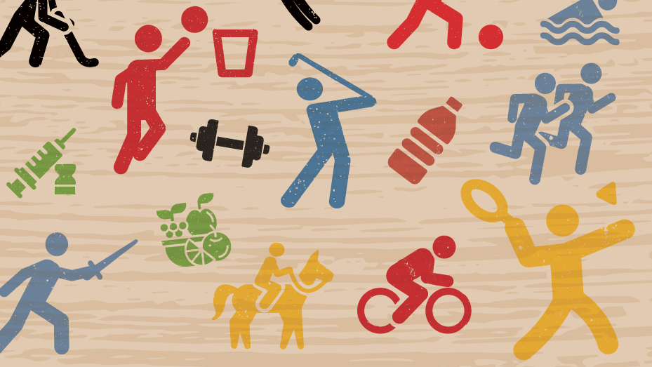
Marathon top 10
Position | Country/territory | Health span (2022)
1 | Japan | 74.37
2 | Singapore | 74.15
3 | South Korea | 73.27
4 | Switzerland | 72.93
5 | Italy | 72.61
6 | France | 72.49
7 | Spain | 72.47
8 | Cyprus | 72.45
9 | Iceland | 72.32
10 | Sweden | 72.32

Slide 64
Our marathon medalists
Gold: Japan
Japan has a population of 124 million. While it ranks 1st for life span and work span, it sits 20th on the Index overall.
Japan has hosted the Summer Olympics twice (1964 and 2020) and has won 497 medals since first competing at Stockholm 1912. It has been most successful at judo – a Japanese sport.
Healthcare in Japan is provided by national and local governments. With an ageing population, Japan introduced a long-term care insurance system in 2000 to combat the health and social care challenges linked to its extraordinary longevity.
Notes:
https://www.nuffieldtrust.org.uk/research/what-can-england-learn-from-the-long-term-care-system-in-japan

Slide 65
Our marathon medalists
Silver: Singapore
Singapore is a city state with a population of 6 million. It ranks 4th on the Index. It has won five medals since its debut at London 1948; one gold, two silver and two bronze. Its gold was won by Joseph Schooling in swimming at Rio 2016.
Singapore has one of the best healthcare systems in the world. It has one of the lowest infant mortality rates globally, high vaccination rates, and its quality of life ratings are very good. Hence, Singaporeans can expect to live longer healthier lives.

Slide 66
Our marathon medalists
Bronze: South Korea
Despite ranking 3rd for healthy life expectancy, South Korea ranks 24th overall on the Index.
South Korea has a very high life expectancy rate – it comes 5th with an average life expectancy of 84 years (the third-highest in the OECD).
However, its ageing population presents a challenge. By 2050, the percentage of the population aged 80+ will reach 16.5% (currently 3.9%). The declining birth rate means its population shrank by 100,000 in 2022.
Notes:
https://www.oecd-ilibrary.org/docserver/7a7afb35-en.pdf?expires=1719829682&id=id&accname=guest&checksum=FC4C5A978F9539043CD6251B47946B27
https://datacommons.org/tools/timeline#&place=country/KOR&statsVar=Count_Person

Slide 67
7. 100m sprint
What is the 100m sprint in our Olympics?
Our 100m sprint looks at regions with the highest percentage of centenarians as a proportion of their populations.
Fun fact: the US has taken the most gold medals for the real Olympic 100m sprint event. Jamaica’s Usain Bolt set a new world record at the 2009 World Athletics Championships in Berlin (9.58s).

Slide 68
How did we measure our 100m sprint?
We calculated our 100m sprint using UN population data.
We found the number of people in each country who were aged 100 or over and divided this by the total population to find the percentage of centenarians.

Slide 69
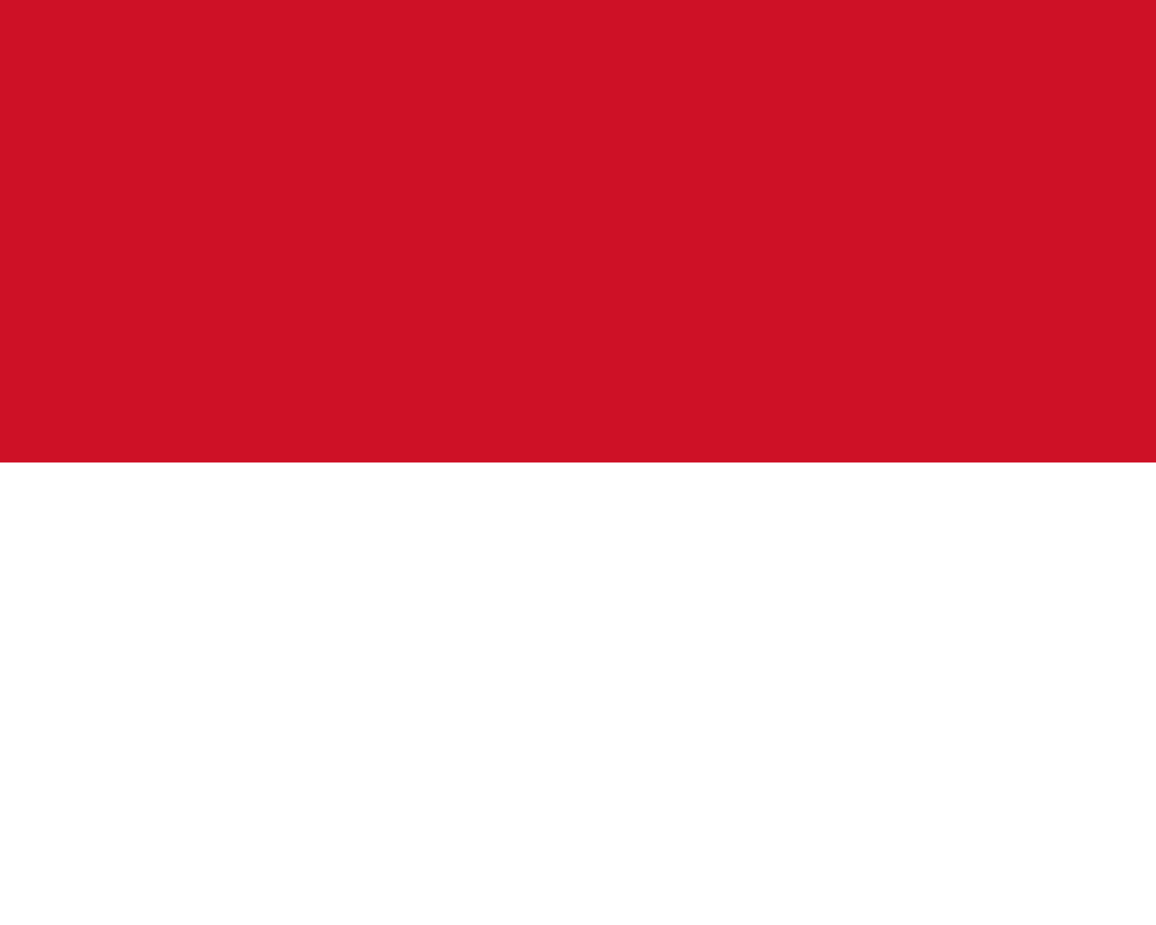

Who wins gold in our 100m sprint?
And the winner is…
1st place: Monaco – 1.056%
2nd place: Japan – 0.105%
3rd place: Guadeloupe – 0.097%

Slide 70
100m sprint top 10
Position | Country/territory | Number of centenarians (% of population)
1 | Monaco | 1.056%
2 | Japan | 0.105%
3 | Guadeloupe | 0.097%
4 | Uruguay | 0.084%
5 | Puerto Rico | 0.078%
6 | Hong Kong | 0.073%
7 | Isle of Man | 0.061%
8 | Gibraltar | 0.057%
9 | Martinique | 0.054%
10 | Thailand | 0.040%

Slide 71
Our 100m sprint medalists
Gold: Monaco
Monaco is a microstate on the French Riviera with a population of around 40,000.
Monaco has never won a medal at the Summer Olympics since first competing at Antwerp 1920. It sent 11 athletes to Rome 1960 – the highest number in the country’s history.
Given its size and the high proportion of millionaires, Monaco’s population is made up of wealthier adults. They’re more likely to have access to good healthcare, which helps them live for longer in better health.

Slide 72
Our 100m sprint medalists
Silver: Japan
As of September 2023, there were 92,139 centenarians in Japan. The country reached 10,000 centenarians in 1998: a nine-fold increase in just a quarter of a century.
Centenarians used to be honoured by the Japanese Government with a silver sake cup.
They’re now given a silver-plated cup instead as a cost-cutting measure.
Notes:
https://www.japantimes.co.jp/news/2023/09/15/japan/centenarians-record-number/
https://www.theguardian.com/world/2016/sep/16/japans-centenarians-hit-by-austerity-as-numbers-soar

Slide 73

Our 100m sprint medalists
Bronze: Guadeloupe
Guadeloupe is an overseas department of France in the Caribbean with a population of almost 380,000.
Guadeloupe is home to a number of French Olympians, including Laura Flessel – a five-time Olympic medalist in women’s fencing, including two gold medals at Atlanta 1996.
Life expectancy at birth in 2023 was 83.3 years, higher than average for the Region of the Americas. This was 5.9 years higher than in 2000. The number of people aged 95 and over has increased by 356% since 2000.
Notes:
https://hia.paho.org/en/countries-22/guadeloupe-profile

Slide 74
8. Relay race
What is the relay race in our Olympics?
Our relay race explores how well economic and political blocs perform on the Healthy Ageing and Prevention Index, compiling different countries under one team.
Fun fact: the US has dominated the 4 x 100m and 4 x 400m relay race in the real Olympics, winning 65 medals across both events for men and women.

Slide 75
How did we measure our relay race?
Our relay race compares the overall healthy ageing scores of the 12 political and economic blocs included in the ILC’s Index.
Each bloc has an overall global rank, as well as individual rankings for each of the six Index metrics.

Slide 76

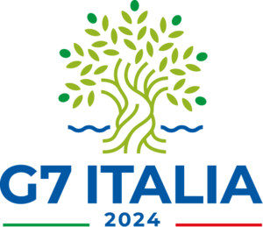

Who wins gold in the Relay race?
And the winner is…
1st place: Nordic Council
2nd place: G7
3rd place: EU

Slide 77
Relay race top 10
Index position (2022) | Country
1 | Nordic Council
2 | Group of Seven (G7)
3 | European Union (EU)
4 | US-Mexico-Canada Agreement (USMCA)
5 | Organisation for Economic Co-operation and Development (OECD)
6 | Asia-Pacific Economic Cooperation (APEC)
7 | Community of Latin American and Caribbean States (CELAC)
8 | Group of 20 (G20)
9 | Association of Southeast Asian Nations (ASEAN)
10 | Brazil, Russia, India, China and South Africa (BRICS)*
*Includes new member states who joined on 1 January 2024.

Slide 78
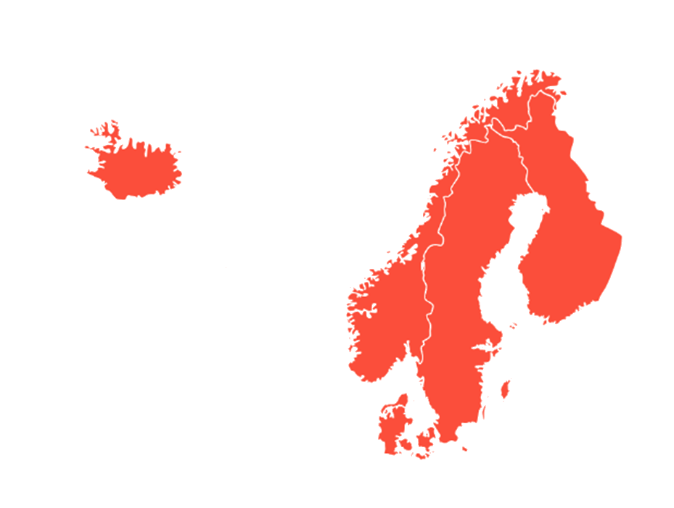
Our relay race medalists
Gold: Nordic Council
Index ranking
The Nordic Council is an inter-parliamentary group that includes Denmark, Finland, Iceland, Norway and Sweden.
The Nordic Council is ranks 1st in every Index metric except work span (where it comes 3rd). The average citizen of this bloc can expect to live for an average of 82.9 years, 71.9 of which would be in good health.
1
12
5
3
9

Slide 79
Our relay race medalists
Silver: G7
The G7 is a political and economic forum consisting of Canada, France, Germany, Italy, Japan, the UK and US.
The G7 has an average life expectancy of 81 and healthy life expectancy of 69.3.
G7 average HLE

Slide 80
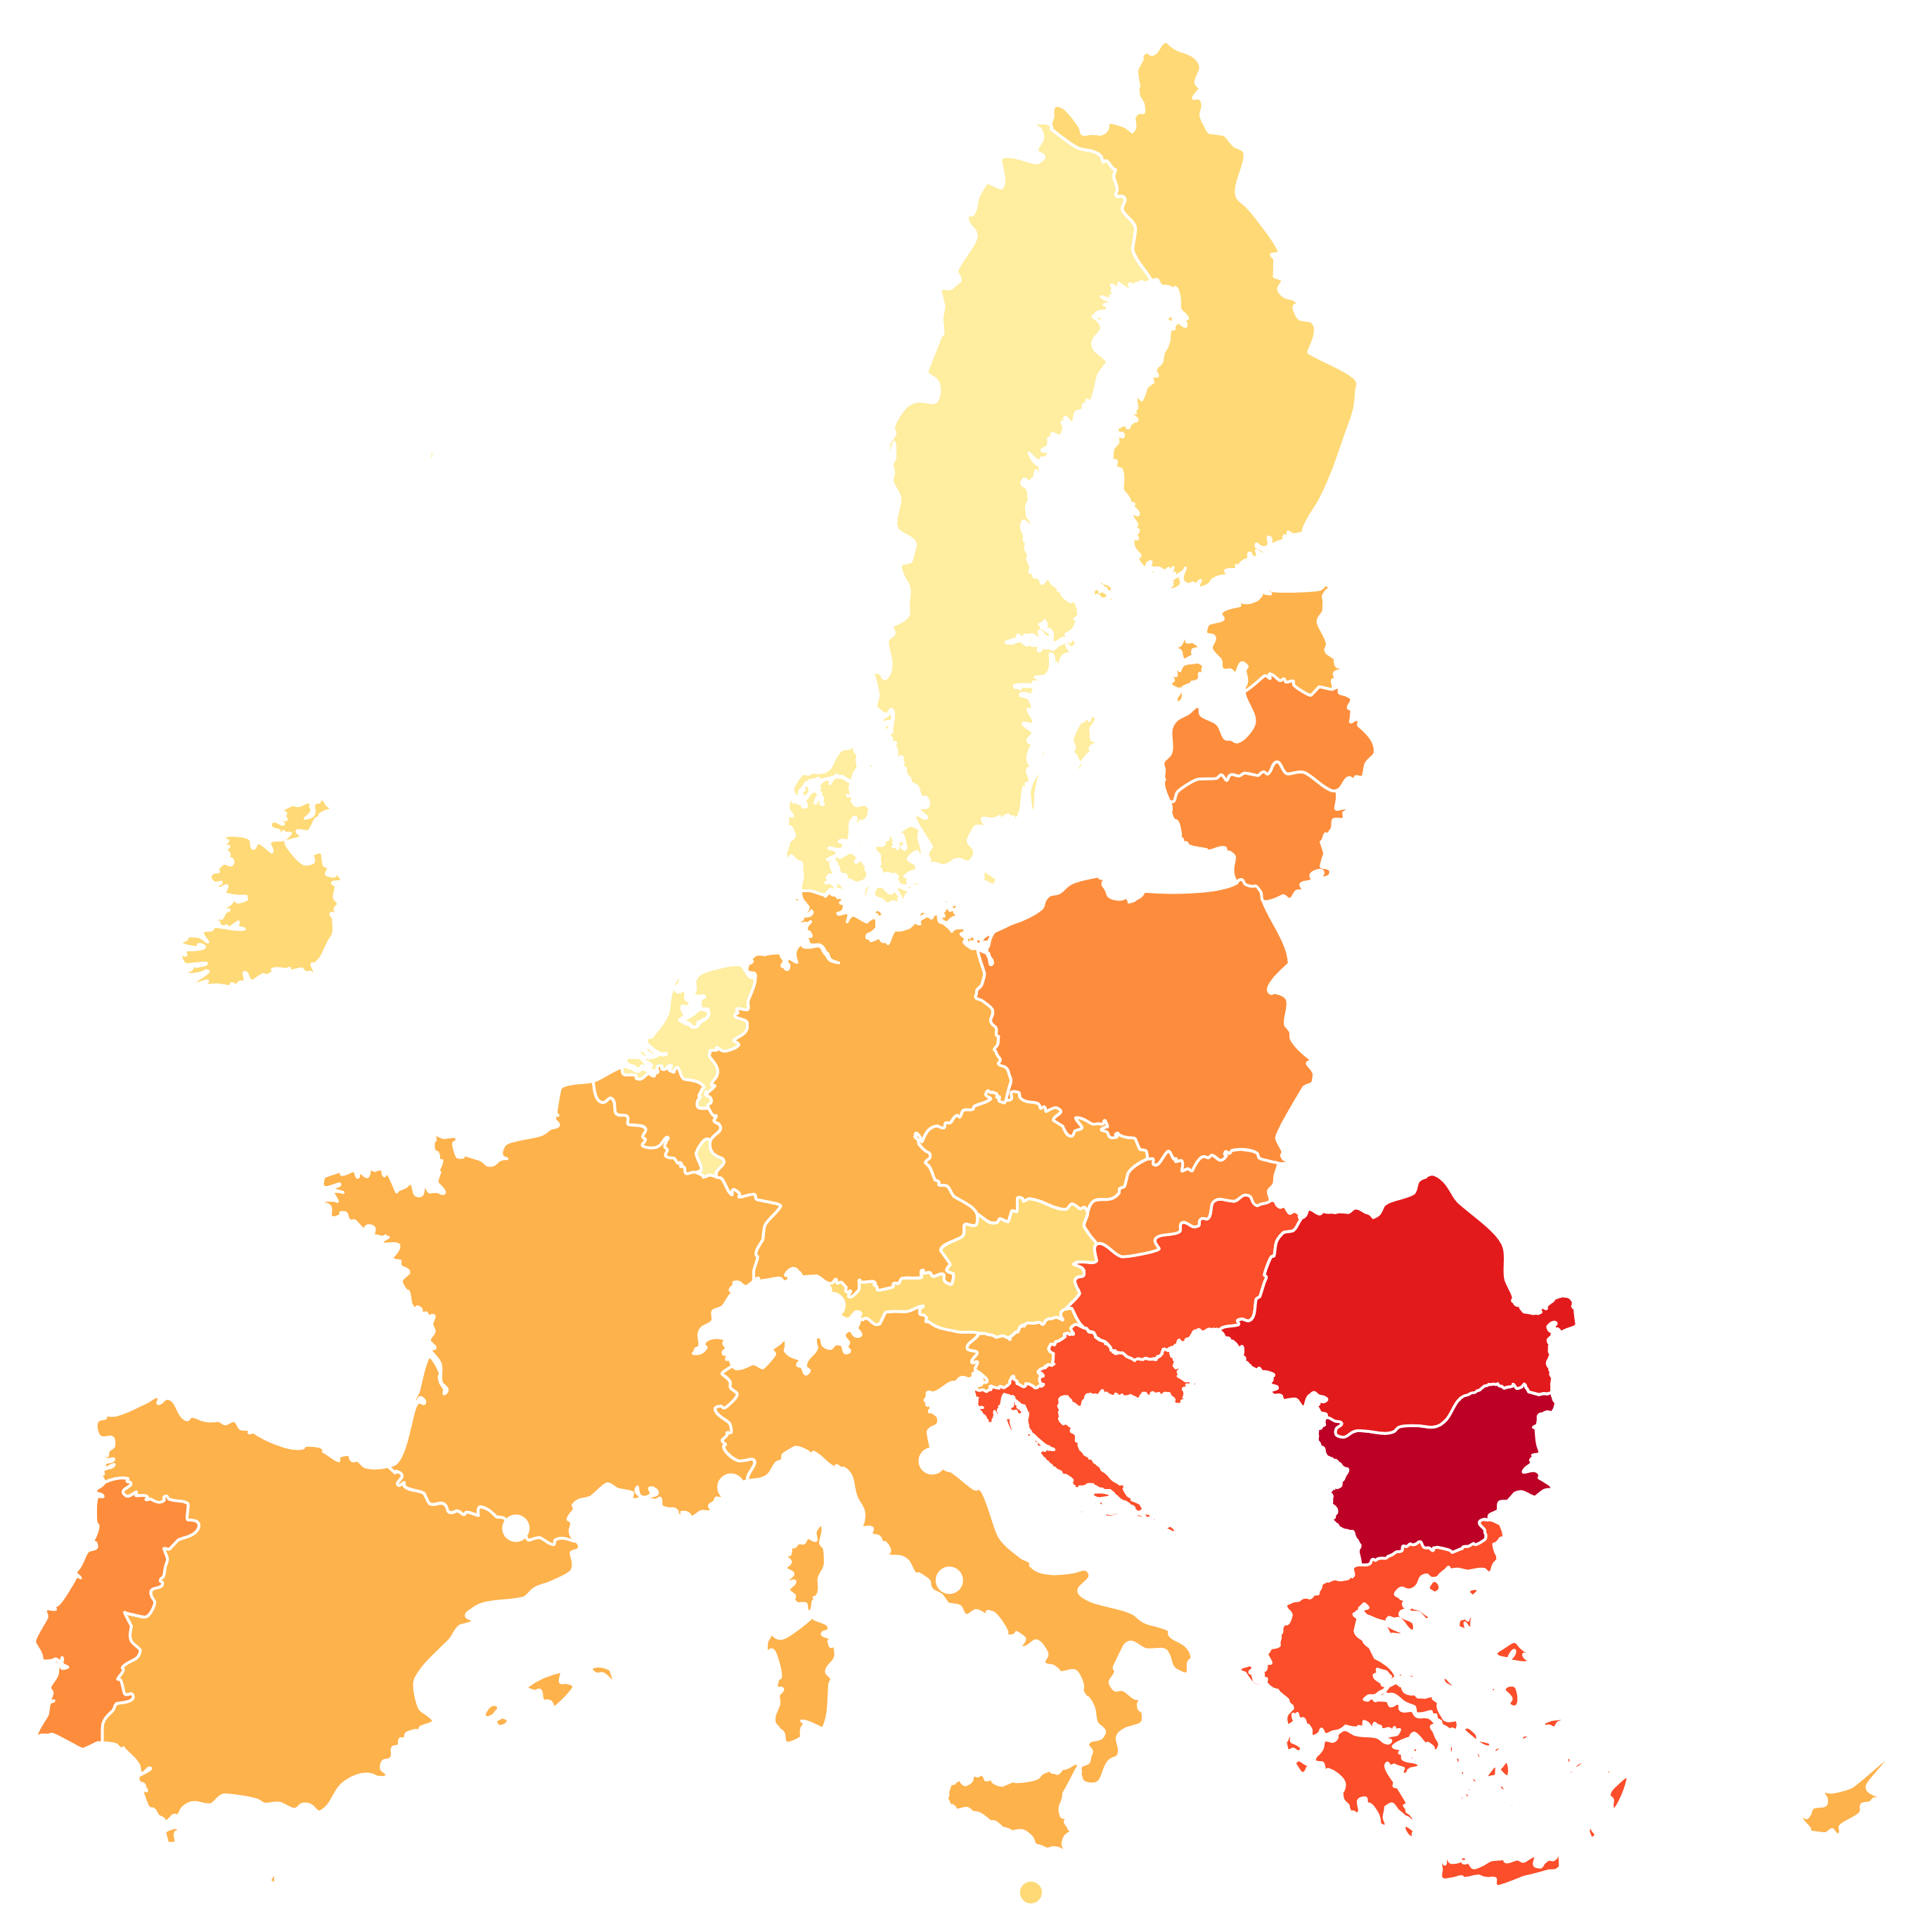
Our relay race medalists
Bronze: EU
The EU is a political and economic bloc made up of 27 countries. EU citizens can expect to live for an average of 81.1 years, with 70.5 in good health.
However, the EU has one of the lowest work spans (28.8 years). There’s also an imbalance between Eastern and Western countries within the bloc.
Index ranking
3
71

Slide 81
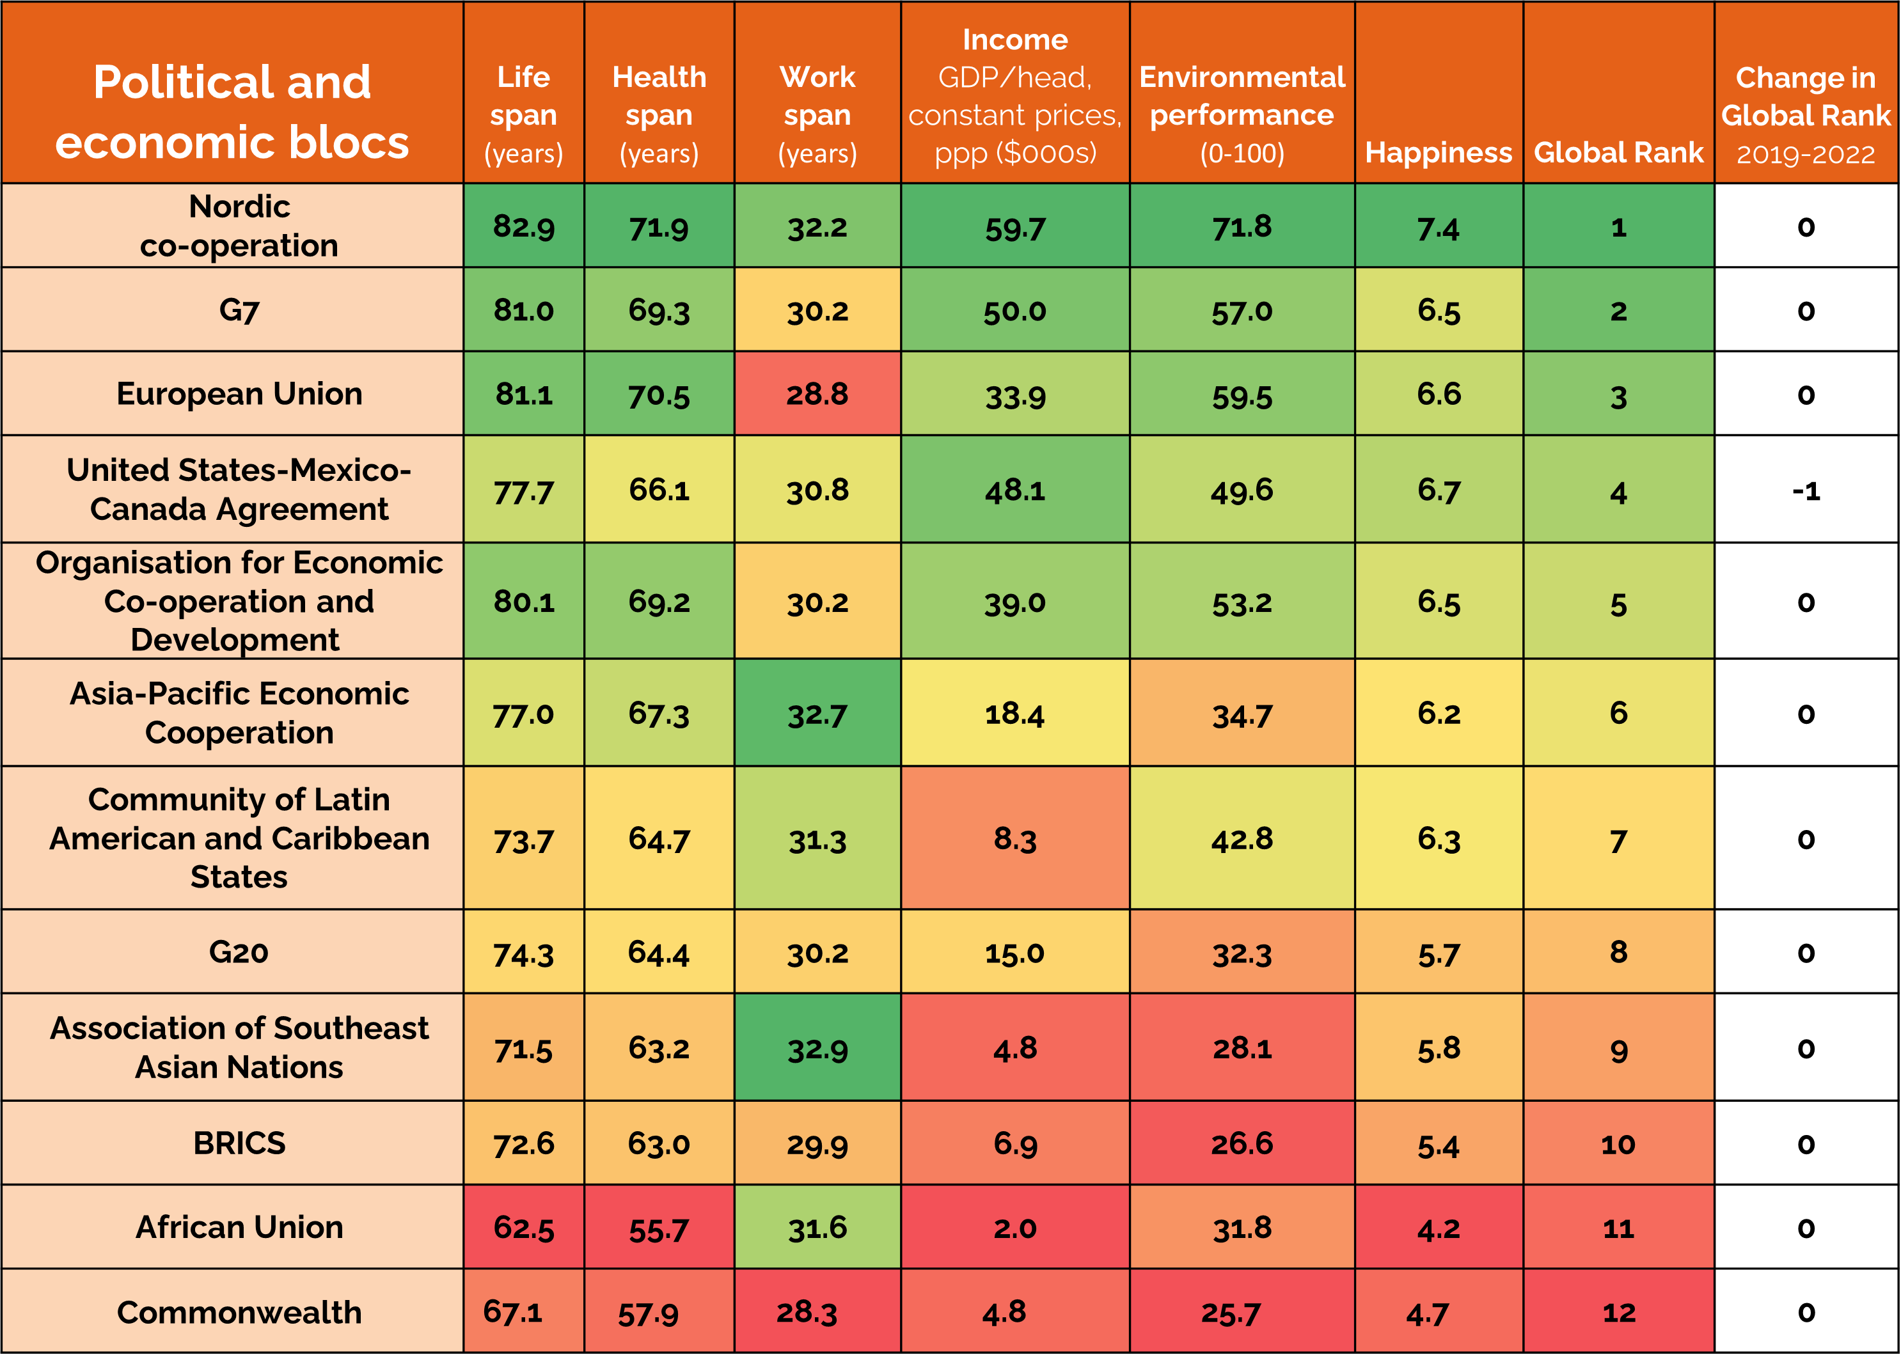
How do blocs compare across each of the Index metrics?
Some blocs perform better across certain metrics, while others perform much worse than their global rank.
Work span is a good example – the EU has the second-lowest work span score, while ASEAN ranks 1st, despite ranking 9th globally.

Slide 82
Recommendations
Contents page

Slide 83
What happens next: how do we improve healthy ageing?
To achieve healthy ageing, countries and territories should:
Invest in health systems: governments should invest more in preventative healthcare and public health initiatives.
Inspire and engage key actors: policymakers, health leaders and citizens need to work together.
Democratise access to healthcare: barriers to preventative interventions need to be removed.
Use technology to deliver prevention: technology should support access to preventative healthcare services.

Slide 84
1. Invest in health systems
Achieving healthy ageing means governments putting their money where their mouth is, by investing more in health:
Policymakers should commit to spending at least 6% of their healthcare budgets on prevention.
Governments should implement national programmes for
life course immunisation and non-communicable disease (NCD) screening.

Slide 85
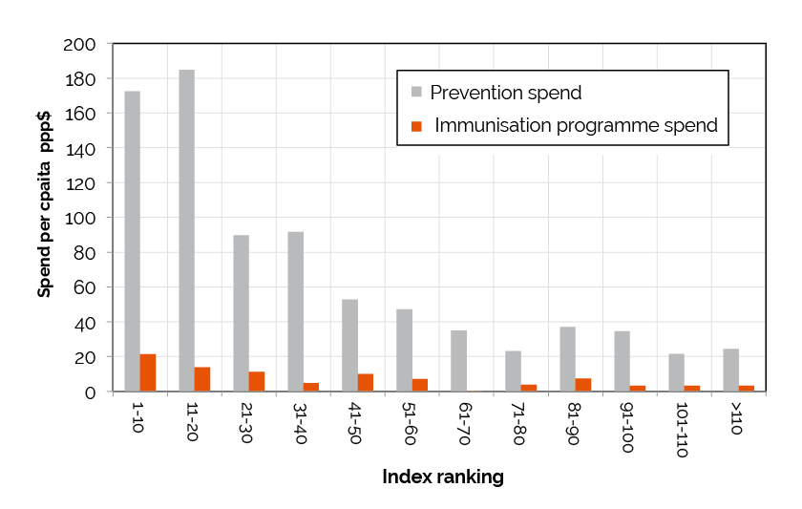
Countries that spend more on prevention live longer, healthier lives
Countries that spend more on prevention perform better on
the Index.
Countries who win medals for immunisation (Jab-elin and Archery) have an average Index position of 35; archery medalists have an average rank of 16th.
Archery medallists' average position
Jab-elin and Archery medallists' average position

Slide 86
2. Inspire and engage
Delivering prevention and achieving healthy ageing requires inspiring policymakers, health leaders and individuals:
Policymakers should ensure healthcare professionals (HCPs) are equipped and trained to deliver preventative interventions i.e. vaccinations and screening services.
Governments and health providers should consider using financial incentives to encourage healthy lifestyle choices and uptake of preventative health interventions.

Slide 87
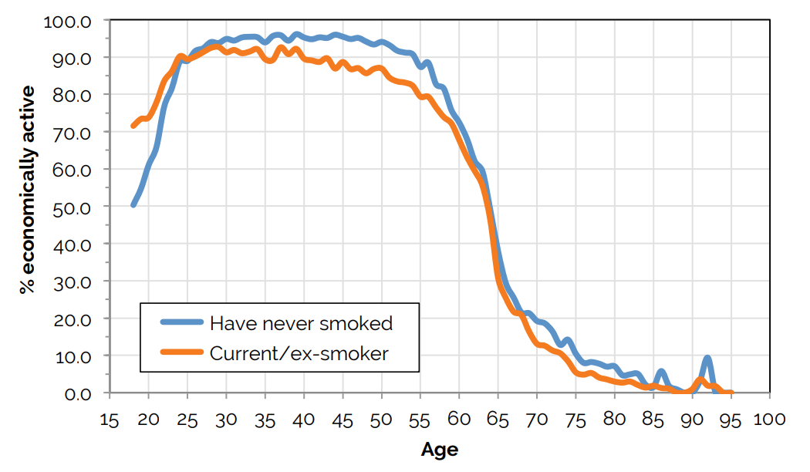
Making healthy lifestyle choices is economically important
Previous ILC research
has highlighted that smoking has led to a £11.5 billion loss per year in economic output in the UK, among male smokers (see graph).
Encouraging people to make healthy choices is important for the economy and personal health.
Notes:
https://ilcuk.org.uk/up-in-smoke/

Slide 88
3. Democratise access
Achieving healthy ageing means granting everybody better access to preventative healthcare services:
HCPs should form partnerships with trusted local actors, e.g. NGOs and community-based organisations, to deliver prevention in local settings such as homes, workplaces and places of worship.
Person-centred care should be a central tenet of healthcare system delivery and healthcare coverage should be made universal.

Slide 89
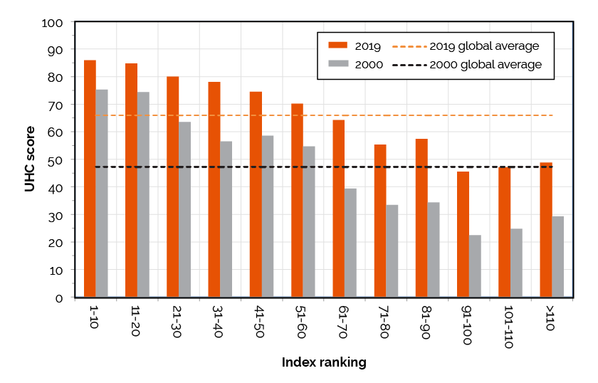
UHC enables people to live longer, healthier lives
Countries that invest in UHC perform better on the Index.
There has been a 40% increase in UHC coverage between 2000 and 2019, with the biggest improvements seen in lower-ranked countries.

Slide 90
4. Use technology
Countries should harness existing and new technologies to deliver prevention and achieve healthy ageing:
Governments should use technologies established during COVID-19 (e.g. mobile apps and dashboards), and patients should have better access and control over their health data.
Policymakers should seek to improve digital skills and literacy among individuals, and HCPs should receive adequate training on using technology for their practices.

Slide 91
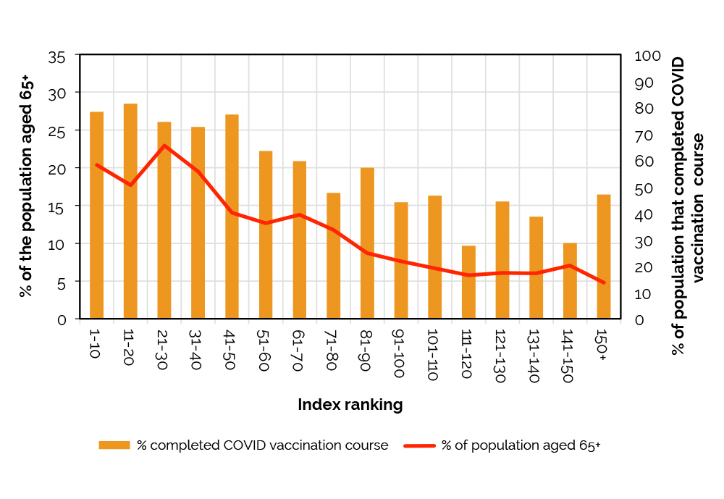
COVID-19 showed how technology can be used to prevent ill health
Novel mRNA technology was developed and rolled out efficiently for COVID-19 vaccines. Vaccination saved over 1.4 million lives in Europe.
Vaccination delivery was successful in regions like the UK, with the creation of the NHS mobile app helping people to book appointments.
Notes:
https://www.who.int/azerbaijan/news/item/16-01-2024-covid-19-vaccinations-have-saved-more-than-1.4-million-lives-in-the-who-european-region--a-new-study-finds

Slide 92
Conclusion
Conclusion
Contents page

Slide 93
Advancing healthy ageing: how do we prepare for Los Angeles 2028?
Governments, policymakers and health leaders should use the next four years and beyond to strive to improve healthy ageing and their populations’ health outcomes.
Since 2019, on the ILC’s Index only 33 out of 153 countries (22%) saw an increase in their overall metric scores. By 2028, we want to see increases across each healthy ageing metric in every country.
By investing more in prevention, promoting it, improving access, and using technology effectively, we believe countries and territories can go for gold and achieve greater health for all.

